Slide 1

TARGET FOLDER
SRNTGT102
Olenogorsk West Missile Factory, SRN
SECRET - DCS WORLD
REL TO COALITION
SECRET - DCS WORLD
REL TO COALITION

Slide 2
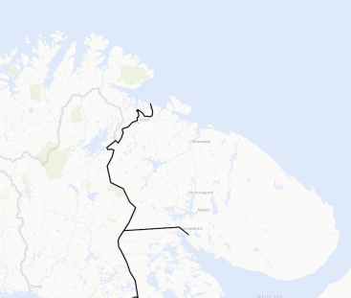
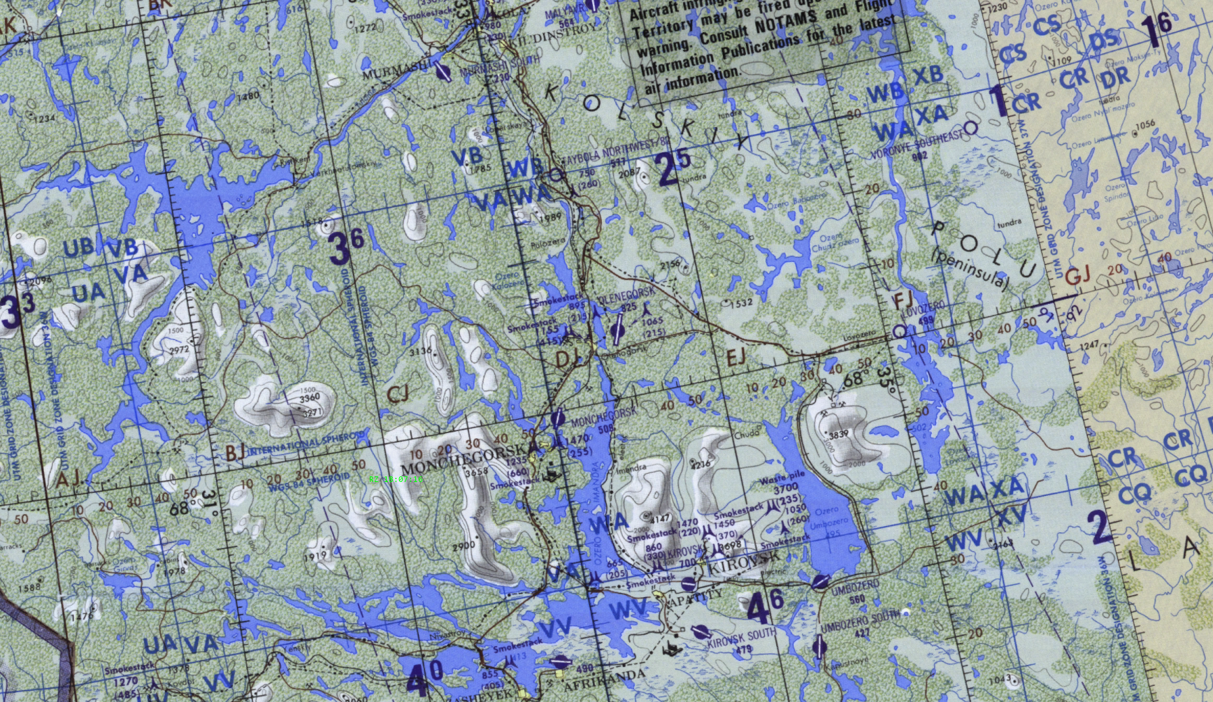
BE: SRNTGT101 CATCODE: 54
MIDB GEO: N 69 03.636 E 033 26.451
ICOD: 05JAN2024 DOI:05JAN2024
Olenogorsk West Missile Factory, SRN
OPAC CLASSIFIED REL TO CJTF-23
JOINT OPERATIONS GRAPHIC 1/1
MAP
OVERVIEW
BE: SRNTGT102 CATCODE: 9
MIDB GEO: N 68 08.670 E 033 26.053
ICOD: 2011-JUL-05 DOI:2011-JUL-05
DECL ON: 2061-JUL-5
N
.
Olenogorsk West Missile Factory SRNTGT102

Slide 3
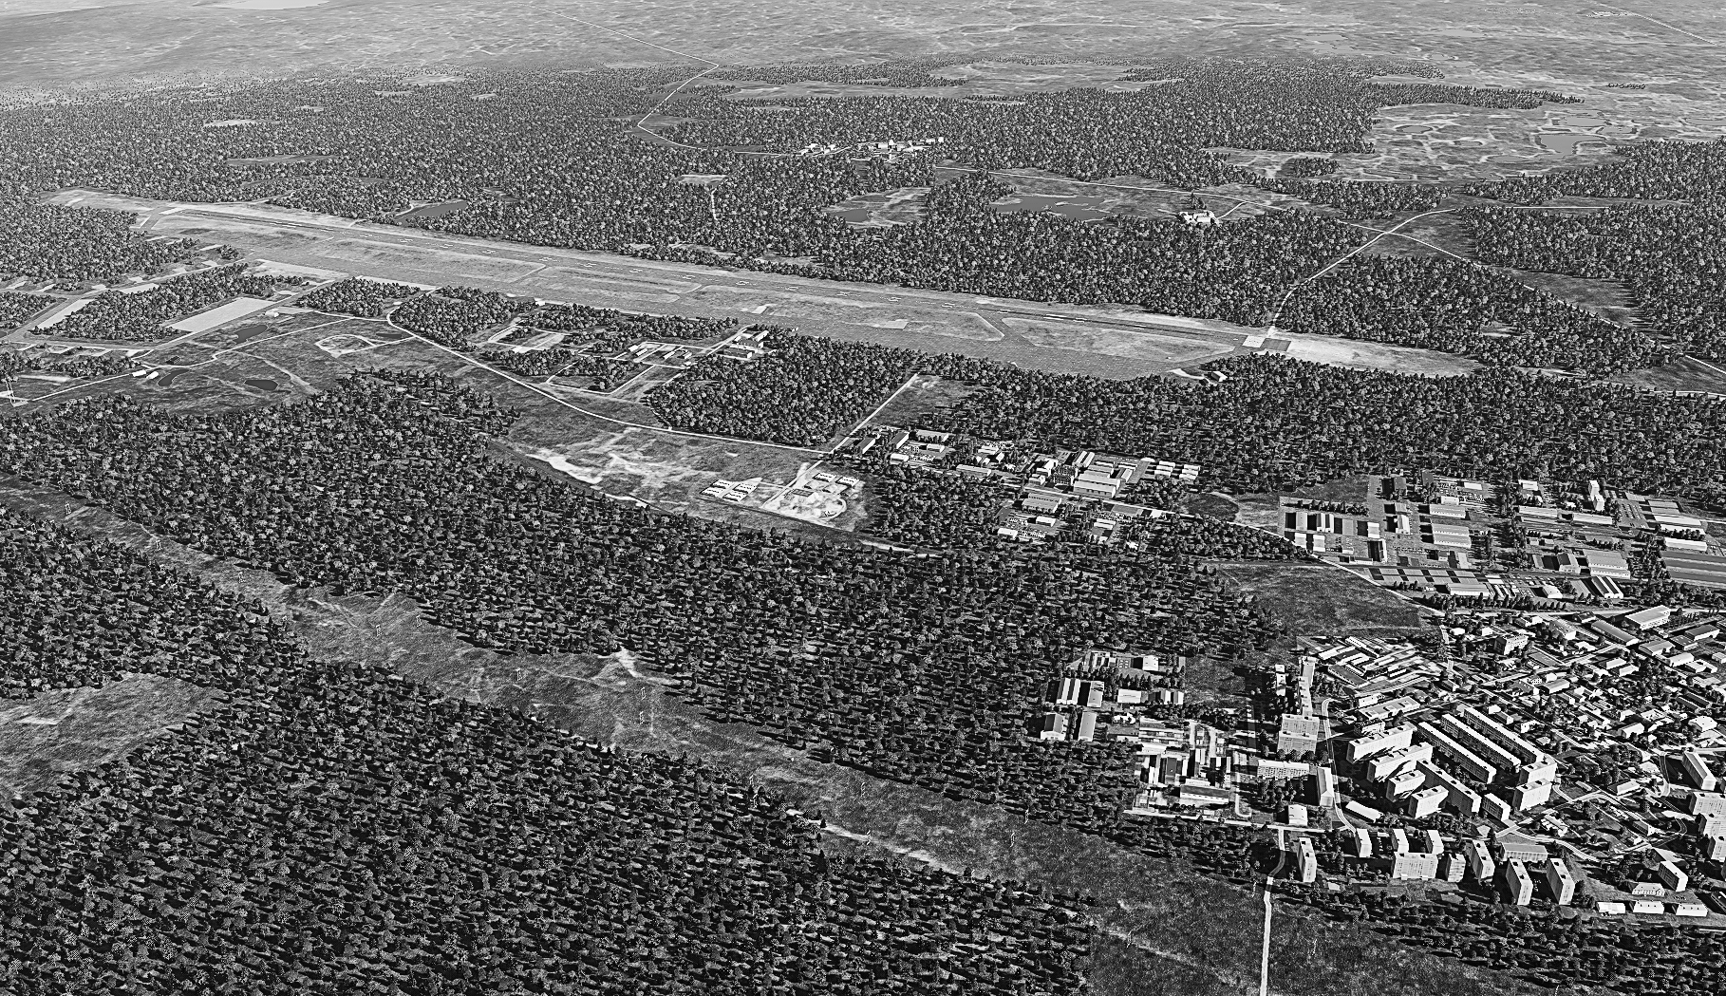
BE: SRNTGT101 CATCODE: 54
MIDB GEO: N 69 03.636 E 033 26.451
ICOD: 05JAN2024 DOI:05JAN2024
Olenogorsk West Missile Factory, SRN
OPAC CLASSIFIED REL TO CJTF-23
FACILITY OUTLINE GRAPHIC 1/1
MAP
OVERVIEW
BE: SRNTGT102 CATCODE: 9
MIDB GEO: N 68 08.670 E 033 26.053
ICOD: 2011-JUL-05 DOI:2011-MAR-11
DECL ON: 2061-JUL-5
N
Olenya Airfield
Olenogorsk West Missile Factory SRNTGT102

Slide 4
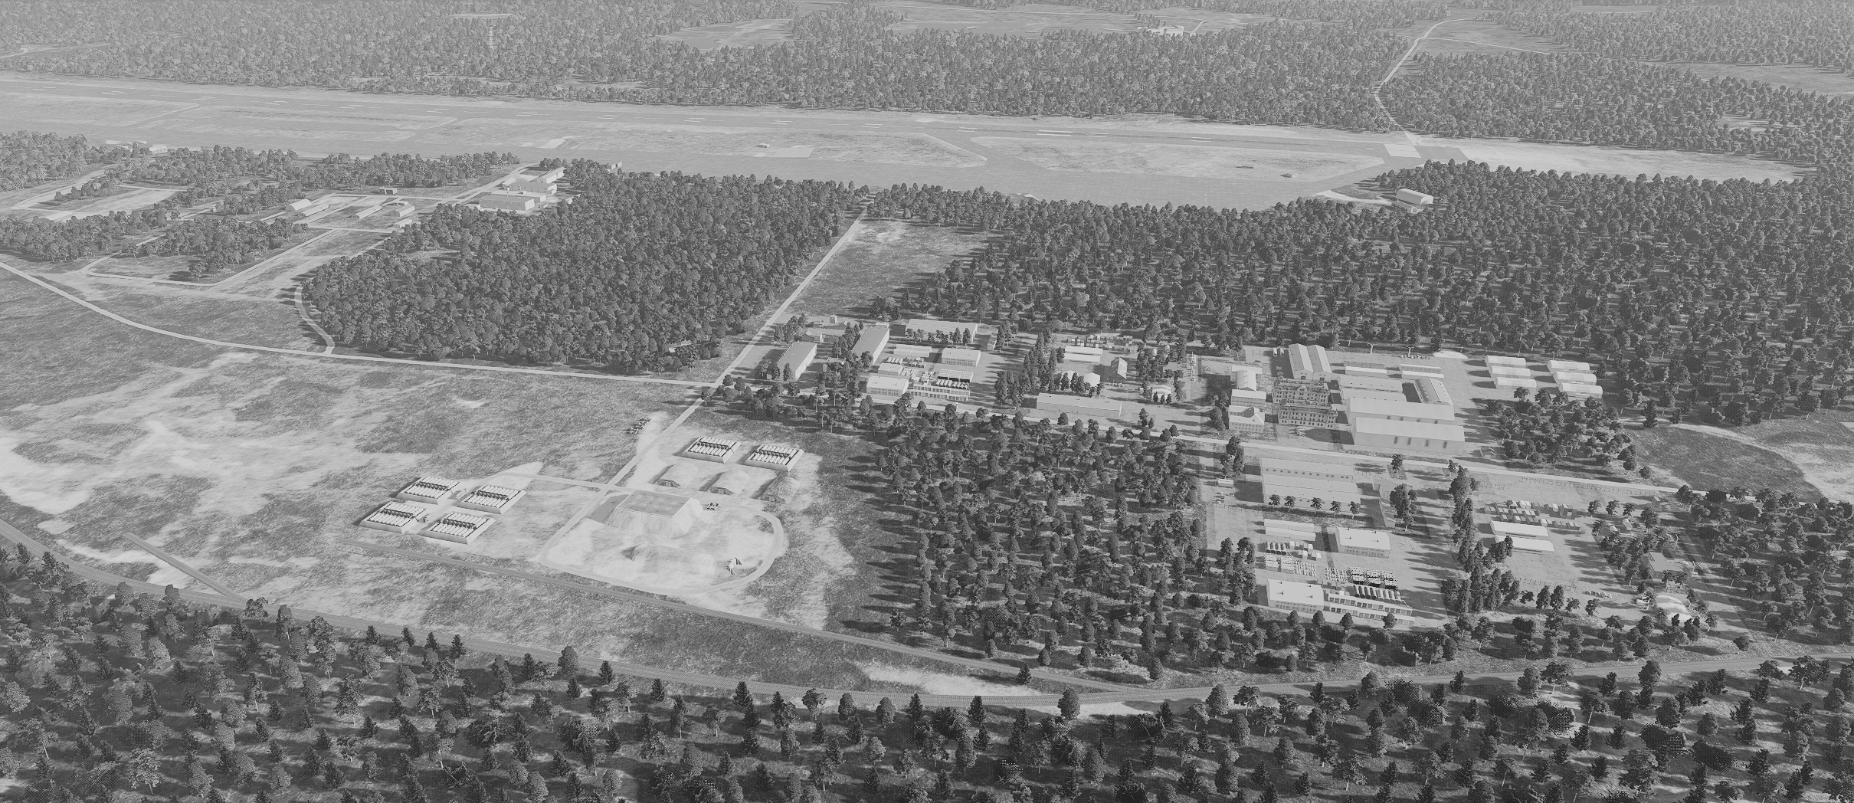
BE: SRNTGT101 CATCODE: 54
MIDB GEO: N 69 03.636 E 033 26.451
ICOD: 05JAN2024 DOI:05JAN2024
Olenogorsk West Missile Factory, SRN
OPAC CLASSIFIED REL TO CJTF-23
DESIRED POINT OF IMPACT GRAPHIC 1/2
MAP
OVERVIEW
BE: SRNTGT102 CATCODE: 9
MIDB GEO: N 68 08.670 E 033 26.053
ICOD: 2011-JUL-05 DOI:2011-MAR-11
DECL ON: 2061-JUL-5
DPI: E
CHEMICAL STORAGE ON GRN
N 68 08.665 E 033 26.024 DPI MSL: 666 FT
DPI: A
MISSILE PRODUCTION ON GRN
N 68 08.634 E 033 26.026 DPI MSL: 664 FT
N
J – FACILITY HQ
PV CHAR: AG MS SF
DPI: C
POWER DISTRIB FACILITY ON GRN
N 68 08.693 E 033 26.007 JDPI MSL: 668 FT
DPI: B
MISSILE PRODUCTION ON GRN
N 68 08.671 E 033 25.940 DPI MSL: 666 FT
DPI: D1
CHEMICAL STORAGE ON GRN
N 68 08.646 E 033 25.948 DPI MSL: 663 FT
DPI: D2
CHEMICAL STORAGE ON GRN
N 68 08.639 E 033 25.942 DPI MSL: 662 FT

Slide 5
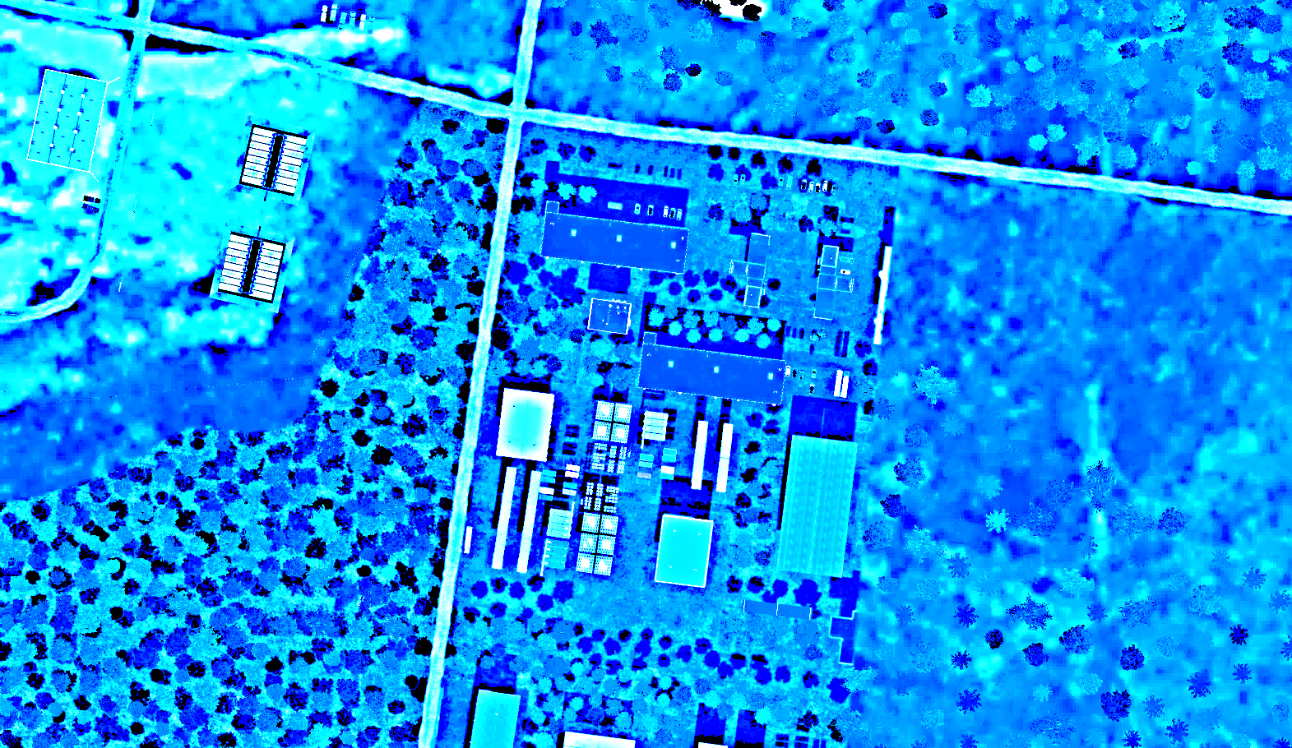
BE: SRNTGT101 CATCODE: 54
MIDB GEO: N 69 03.636 E 033 26.451
ICOD: 05JAN2024 DOI:05JAN2024
Olenogorsk West Missile Factory, SRN
OPAC CLASSIFIED REL TO CJTF-23
DESIRED POINT OF IMPACT GRAPHIC 2/2
MAP
OVERVIEW
BE: SRNTGT102 CATCODE: 9
MIDB GEO: N 68 08.670 E 033 26.053
ICOD: 2011-JUL-05 DOI:2011-MAR-11
DECL ON: 2061-JUL-5
N
DPI: C
POWER DISTRIB FACILITY ON GRN
N 68 08.693 E 033 26.007 JDPI MSL: 668 FT
DPI: E
CHEMICAL STORAGE ON GRN
N 68 08.665 E 033 26.024 DPI MSL: 666 FT
DPI: B
MISSILE PRODUCTION ON GRN
N 68 08.671 E 033 25.940 DPI MSL: 666 FT
DPI: A
MISSILE PRODUCTION ON GRN
N 68 08.634 E 033 26.026 DPI MSL: 664 FT
DPI: D1
CHEMICAL STORAGE ON GRN
N 68 08.646 E 033 25.948 DPI MSL: 663 FT
DPI: D2
CHEMICAL STORAGE ON GRN
N 68 08.639 E 033 25.942 DPI MSL: 662 FT

Slide 6
BE: SRNTGT101 CATCODE: 54
MIDB GEO: N 69 03.636 E 033 26.451
ICOD: 05JAN2024 DOI:05JAN2024
Olenogorsk West Missile Factory, SRN
OPAC CLASSIFIED REL TO CJTF-23
WEAPONEERING OPTIONS 1/1
MAP
OVERVIEW
BE: SRNTGT102 CATCODE: 9
MIDB GEO: N 68 08.670 E 033 26.053
ICOD: 2011-JUL-05 DOI:2011-MAR-11
DECL ON: 2061-JUL-5
JDPI | DESCRIPTION | TLE | WARHEAD | GUIDANCE | DESIRED EFFECT | IMPACT ANGLE | FUZING
A | MISSILE PRODUCTION PLANT 1 | CAT 2 | 1000 lbs | DECIMETRIC | BLAST, FRAGMENTATION | 60-90 | 25ms
B | MISSILE PRODUCTION PLANT 2 | CAT 2 | 1000 lbs | DECIMETRIC | BLAST, FRAGMENTATION | 60-90 | 25ms
C | POWER DISTRIBUTION FACILITY 1 | CAT 2 | 1000 lbs | METRIC | BLAST, FRAGMENTATION | 60-90 | 25ms
D1 | CHEMICAL STORAGE | CAT 2 | 1000 lbs | METRIC | BLAST, FRAGMENTATION | 60-90 | 0ms
D2 | CHEMICAL STORAGE | CAT 2 | 1000 lbs | METRIC | BLAST, FRAGMENTATION | 60-90 | 0ms
E | CHEMICAL STORAGE | CAT 2 | 1000 lbs | METRIC | BLAST, FRAGMENTATION | 60-90 | 0ms

Slide 7
BE: SRNTGT101 CATCODE: 54
MIDB GEO: N 69 03.636 E 033 26.451
ICOD: 05JAN2024 DOI:05JAN2024
Olenogorsk West Missile Factory, SRN
OPAC CLASSIFIED REL TO CJTF-23
COLLATERAL DAMAGE ESTIMATION GRAPHIC [X]
MAP
OVERVIEW
BE: SRNTGT102 CATCODE: 9
MIDB GEO: N 68 08.670 E 033 26.053
ICOD: 2011-JUL-05 DOI:2011-MAR-11
DECL ON: 2061-JUL-5
600ft
N
DPI C
NCC: SRNTGT004
400FT W FROM DPI B/C
DPI B
CDE 5

Slide 8
BE: SRNTGT101 CATCODE: 54
MIDB GEO: N 69 03.636 E 033 26.451
ICOD: 05JAN2024 DOI:05JAN2024
Olenogorsk West Missile Factory, SRN
OPAC CLASSIFIED REL TO CJTF-23
COLLATERAL DAMAGES ESTIMATION 1/1
MAP
OVERVIEW
BE: SRNTGT102 CATCODE: 9
MIDB GEO: N 68 08.670 E 033 26.053
ICOD: 2011-JUL-05 DOI:2011-MAR-11
DECL ON: 2061-JUL-5
COLLATERAL DAMAGES WITHIN A 500M RADIUS
DESCRIPTION |  | CATCODE | MIDB GEOS | LOCATION | REMARKS
Fuel Storage Tanks |  | 9 |  | 600ft W of DPI B,C | Fuel Storage can cause secondary explosions
Ammo Storage Containers |  | 9 |  | 800ft W of DPI B,C | Ammo Storage can cause secondary explosions
Industrial Units |  | 13 |  | 400ft S of DPI A | Potential loss of civilian life
NO STRIKE ENTITIES WITHIN A 500M RADIUS
NSE ID | DESCRIPTION | CATCODE | MIDB GEOS | LOCATION | REMARKS

Slide 9
BE: SRNTGT101 CATCODE: 54
MIDB GEO: N 69 03.636 E 033 26.451
ICOD: 05JAN2024 DOI:05JAN2024
Olenogorsk West Missile Factory, SRN
OPAC CLASSIFIED REL TO CJTF-23
BATTLE DAMAGE ASSESSMENT GRAPHIC 1
MAP
OVERVIEW
BE: SRNTGT102 CATCODE: 9
MIDB GEO: N 68 08.670 E 033 26.053
ICOD: 2011-JUL-05 DOI:2011-MAR-11
DECL ON: 2061-JUL-5
POST-STRIKE
PRE-STRIKE
TARGET OBJECTIVE
DAMAGE/CHANGE ASSESSMENT
JDPI:[XXXXXX]
BDA REMARK: [CLASSIFICATION] [DISSEMINATION] Assessment: Physical Damage/change, Collateral Damage, Functional Damage/change, Munitions Effectiveness, Reattack Recommendation, Additional/Collateral Effects

Slide 10

ACRONYMS
ACRONYM | MEANING | DEFINITION
BE | Basic Encyclopedia Number | Alpha/numeric code unique to an installation for incorporation within various national and tactical systems.
CATCODE | Category Code | The data Element that classifies the function and purpose of an installation or a facility.
MIDB | Modernized Integrated Database | A database comprised of information on facilities of military significance, military forces, and related equipment.
ICOD | Intelligence Cut Off Date | The date of the latest intelligence data inputted to a feature.
DOI | Date of Image | Date on which a geospatial or intelligence-related image was captured.
CE | Critical Element | An element of an entity or object that enables it to perform its primary function.
JDPI | Joint Desired Point of Impact | A unique, alphanumeric coded aimpoint identified by a three dimensional mensurated point. It represents a weapon or capability desired point of impact or penetration.
CE90 | Circular Error at 90% | 90 percent confidence level in the horizontal plane.
LE90 | Linear Error at 90% | 90 percent confidence level in the vertical dimension
MSL | Mean Sea Level | Elevation above Earth reference geoid.
AGL | Above Ground Level | Elevation above ground surface.
NCC | Nearest Collateral Concern | Closest non-targeted structure, area, or entity near a planned point of impact that may be at risk of unintended damage during a military strike.
CER | Collateral effects radius | Radius within which collateral damage might happen based on the weapon's characteristics, the target environment, and other operational factors.
CDE | Collateral damage estimate | Systematic process used in military targeting to evaluate the potential for unintended damage or harm to non-combatant entities, structures, or personnel as a result of a planned strike.
NSE | No Strike Element | Specific entities, locations, or objects that are protected from intentional targeting under the Law of Armed Conflict (LOAC) or by operational policy.

Slide 11
MILITARY KILL EFFECTS
Definition: destructive effects available upon detonation of a weapon.
KILL EFFECT |  | DEFINITION
BLAST |  | The high-pressure shockwave created by an explosion, traveling outward from the detonation point. Blast effects cause destruction by overpressure (compression force) and dynamic pressure (wind generated by the expanding gases), which can demolish structures, damage equipment, and injure personnel.
FRAGMENTATION |  | The dispersal of shrapnel or debris from an exploding munition. Fragments are propelled outward at high velocity, targeting personnel, equipment, and light structures in the area of effect.
PENETRATION |  | The effect of a munition or projectile piercing a target's surface without fully passing through it. Penetration is often used to defeat hardened targets, such as bunkers, by transferring energy into the target's structural layers.
INCENDIARY |  | The combustion of materials caused by incendiary munitions, secondary explosions, or the heat from a blast. Fire destroys flammable materials and can cause secondary damage to structures and equipment, as well as injuries to personnel.
CRATERING |  | The formation of a crater in the ground caused by the impact or detonation of a munition. Cratering disrupts mobility and operations, damaging roads, runways, or creating obstacles in the battlefield.
PERFORATION |  | The complete passage of a munition or projectile through a target, creating both an entry and exit point. Perforation may reduce the energy transfer to the target, making it less effective for destroying heavily armored or reinforced structures.
EARTH SHOCK |  | The seismic-like vibrations transmitted through the ground from an explosion. Earth shock can damage underground structures, destabilize foundations, or incapacitate personnel in subterranean environments.
NUCLEAR RADIATION |  | The release of ionizing radiation (alpha, beta, gamma, and neutron particles) from a nuclear explosion. Nuclear radiation can cause immediate biological damage, long-term health effects, and contamination of the environment.
THERMAL RADIATION |  | The intense heat and light energy emitted by an explosion, especially in nuclear detonations. Thermal radiation causes burns, ignites materials, and can create secondary fires in the target area.

Slide 12
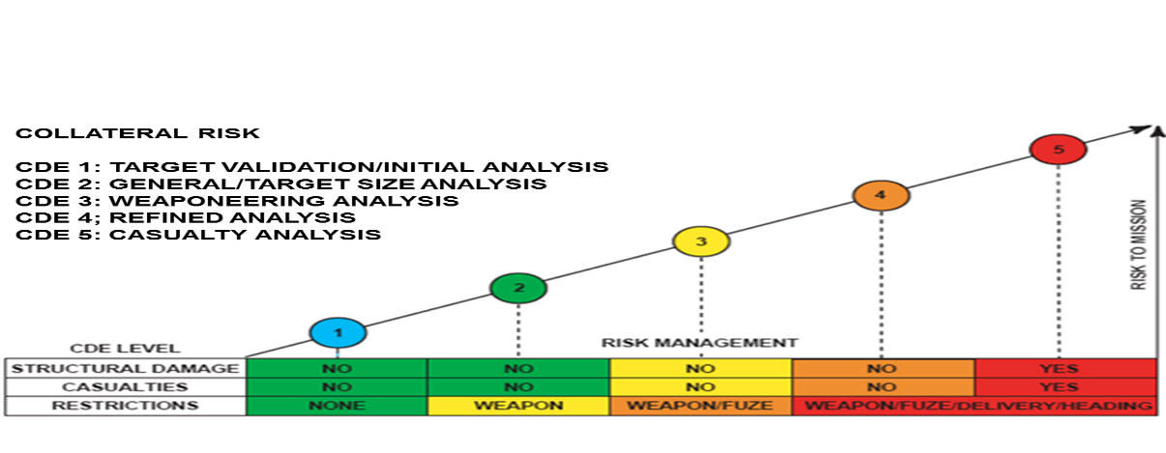
Collateral Damage Estimation Levels

Slide 13
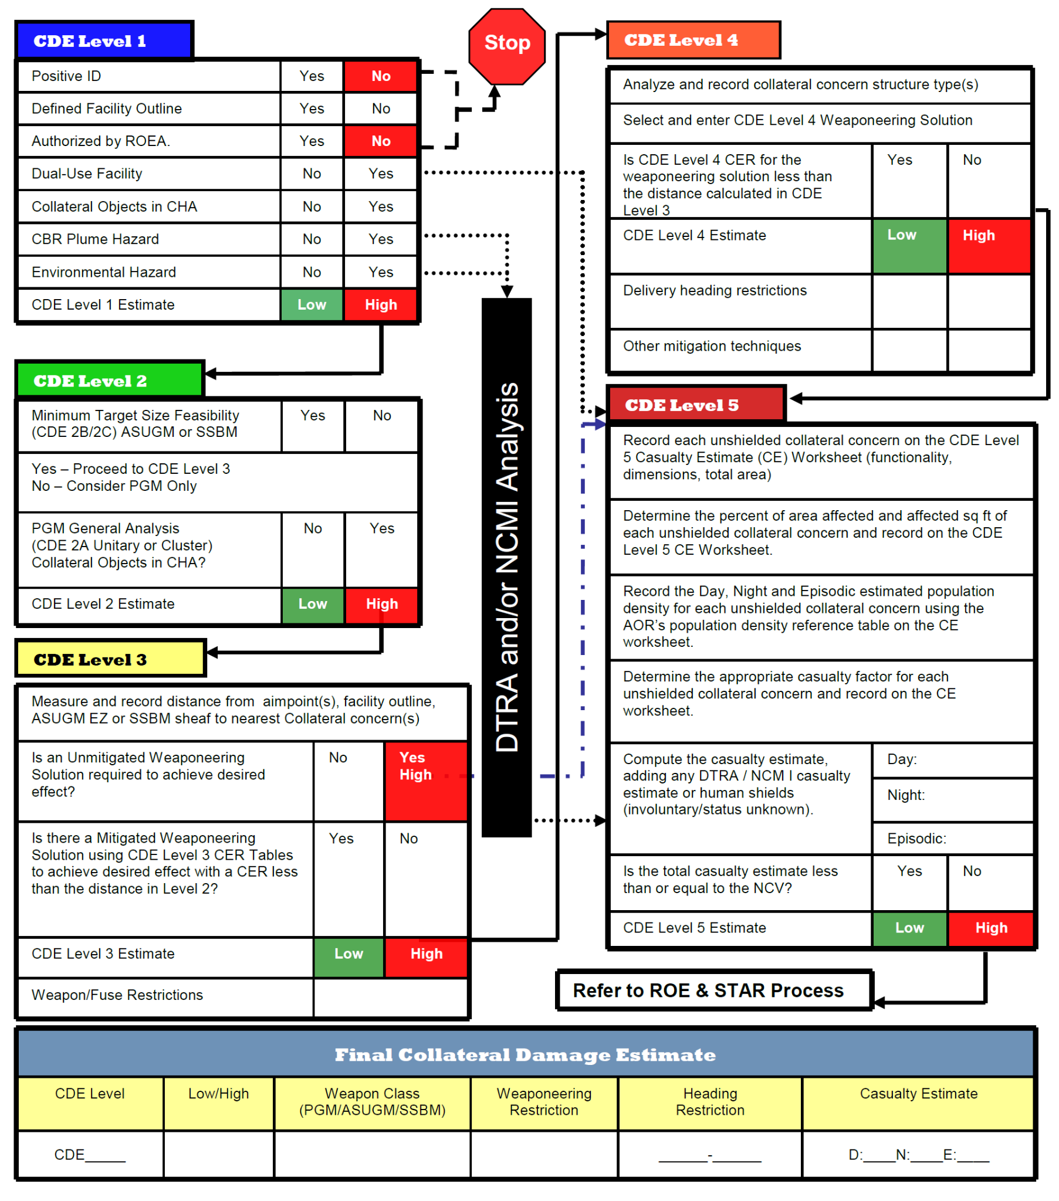
Collateral Damage Estimation Methodology

Slide 14
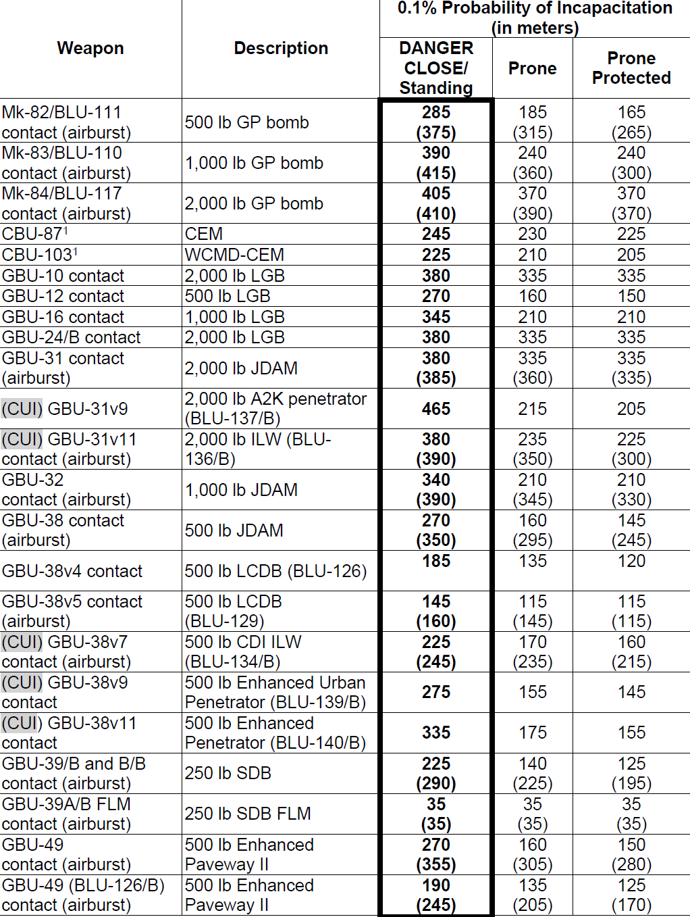
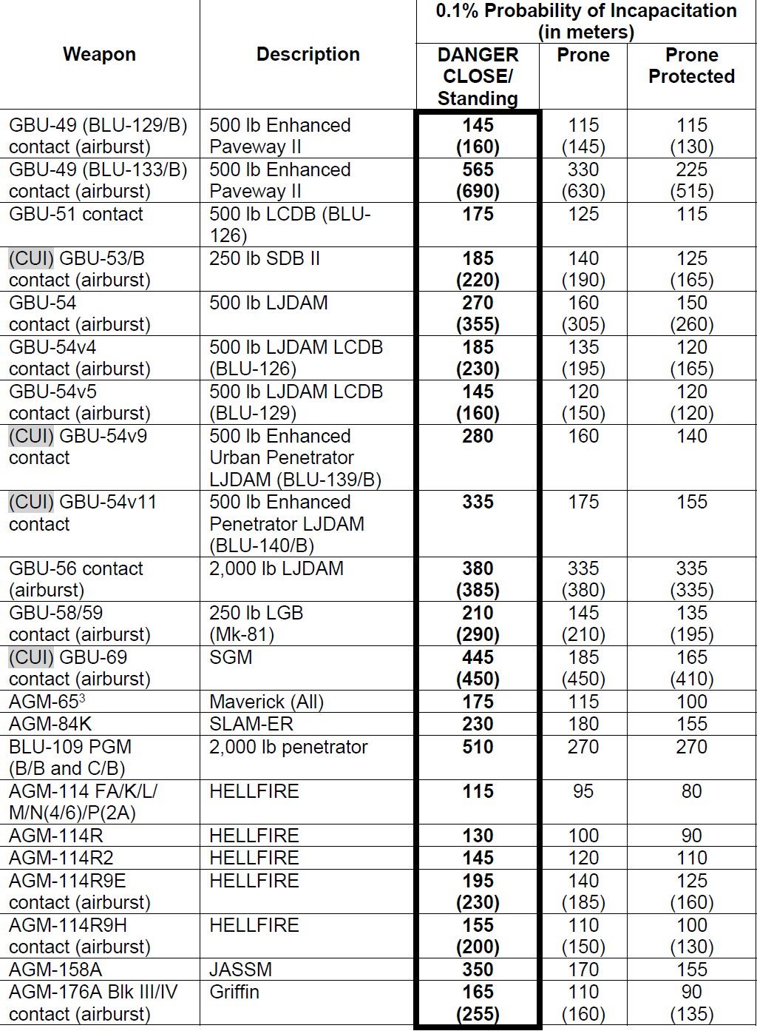
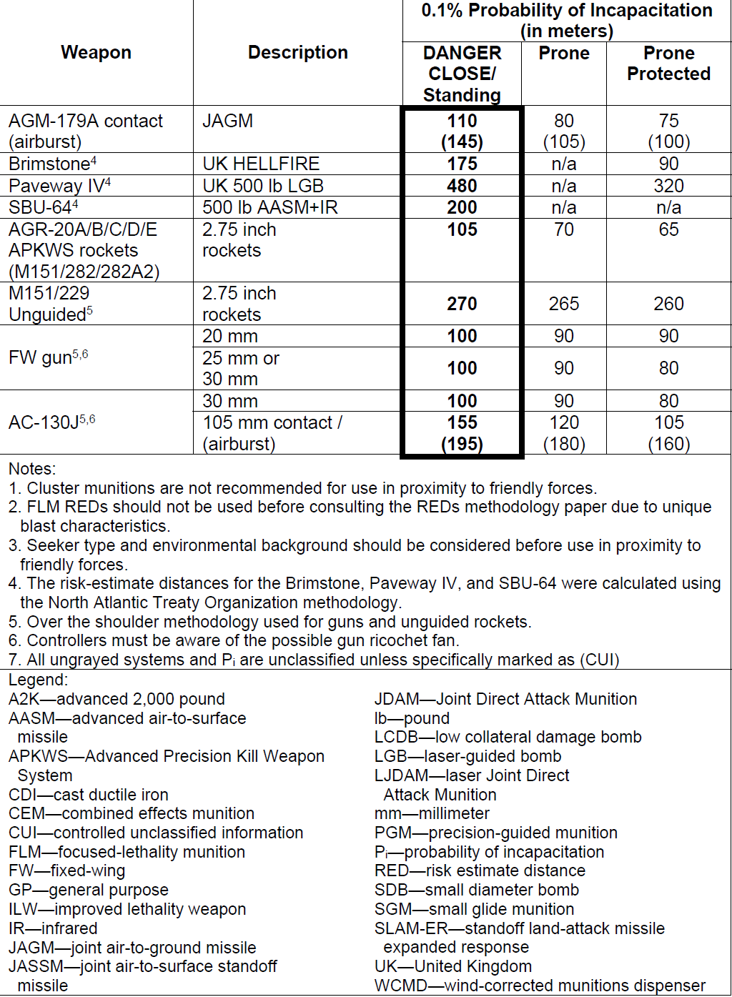
Risk Estimate Distance Table
(Fixed-Wing, 2023)

